Slide 1
The Joy of Receiving, Managing, and Sharing God’s Blessings
Presentation to Church Leaders
on Stewardship
Ron Chewning, Stewardship Advisors Copyright © 2015

Slide 2

Coming soon!
“Experiencing the Joy of Generosity”
A Three-week Stewardship Emphasis

Slide 3
Part One: The Joy of Receiving God’s Blessings
God has adopted us as His children (Ephesians 1:5). God loves us even more than we love ourselves (John 3:16). He wants us to experience His very best (John 10:10). When we receive God’s blessings with gratitude, manage His blessings faithfully, and share them generously, we will be filled with joy, knowing that we are following His ways and giving Him honor and glory.

Slide 4
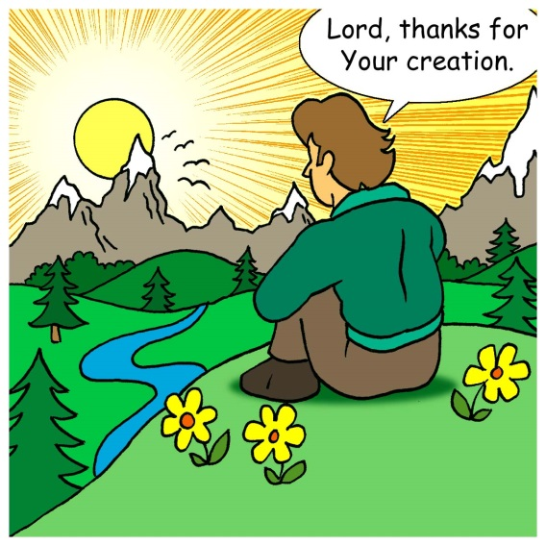
The Joy of Receiving God’s Blessings
Most Elemental Biblical Attitudes toward Life:
God gives—We receive
God owns—We manage
God first loved—We can love
God gives—We can give
God invites—We follow
Etc.

Slide 5
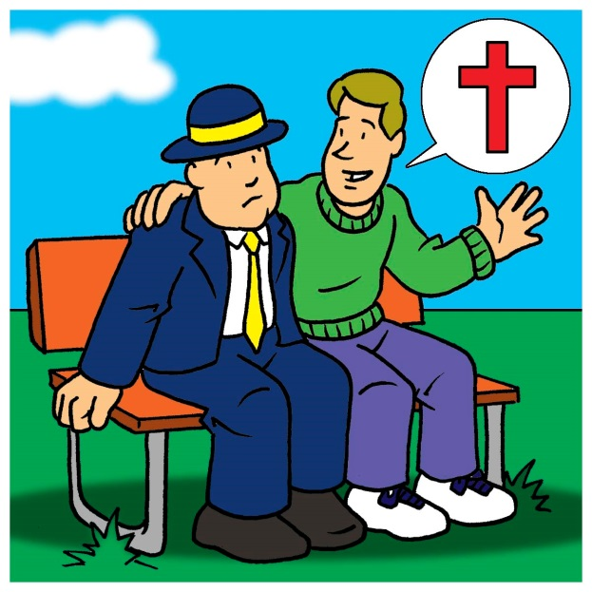
The Joy of Receiving God’s Blessings
Jesus demonstrated a capacity for receiving:
“For I was hungry and you gave Me food, I was thirsty and you gave Me drink, I was a stranger and you welcomed Me, I was naked and you clothed Me, I was sick and you visited Me, I was in
prison and you came to Me”
(Matthew 25:36-38).

Slide 6
The Joy of Receiving God’s Blessings
God’s Word tells us:
“Know that the Lord, He is God! It is He who made us, and we are His” (Psalm 100:3).
“…Give me neither poverty nor riches…” (Proverbs 30:8).
“Freely you have received, freely give” (Matthew 10:8 NIV).
“What do you have that you did not receive? If then you received it, why do you boast as if you did not receive it” (1 Corinthians 4:7).
“Every good and perfect gift is from above” (James 1:17).

Slide 7
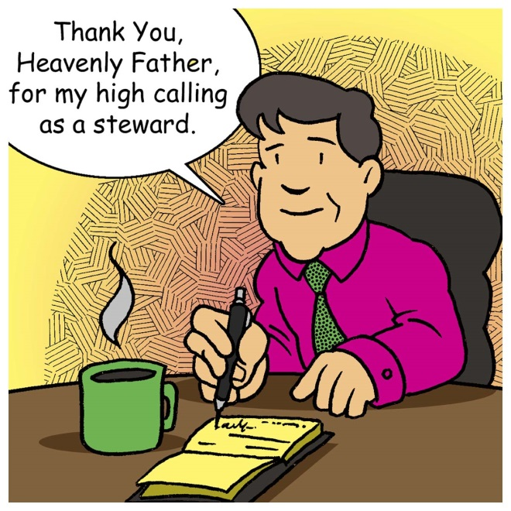
The Joy of Receiving God’s Blessings
The Apostle Paul in 1 Timothy 6:17 wrote, “As for the rich in this present age, charge them not to be haughty, nor to set their hope on the uncertainty of riches, but on God, Who richly provides us with everything to enjoy.”
The gifts from God’s hand are
to be received for our enjoyment
with thanksgiving.

Slide 8
The Joy of Receiving God’s Blessings
Albert Einstein’s perspectives on receiving:
“A hundred times every day I remind myself that my inner and outer life depend on the labors of others, living and dead, and that I must exert myself in order to give in the same measure as I have received and am still receiving.”

Slide 9
The Joy of Receiving God’s Blessings
Are you a better giver or receiver?
Sometimes it’s more important to learn how to receive- more important and more difficult.
Giving gifts feels good. You’ve done something nice for others, improved their lives in some way. Giving makes us feel meaningful.
Receiving a gift can be painful. It can make us feel dependent, and obligated. When someone buys us a gift, we think we have to return the favor.
Why can being a poor receiver challenge us spiritually?

Slide 10
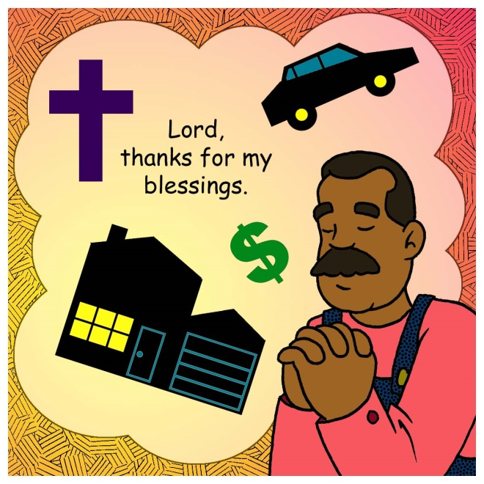
The Joy of Receiving God’s Blessings
Jesus said, “It is more blessed to give than to receive” (Acts 20:35).
However, we cannot give
until we have first received.
We cannot bless others until
we first receive for ourselves
God’s blessings.

Slide 11

The Joy of Receiving God’s Blessings
When the focus is on receiving, our thinking changes from “How much do I give to God of what is mine?” to “How much of God’s do I keep for myself?”

Slide 12
The Joy of Receiving God’s Blessings
The Apostle Paul wrote: “Now we have received not the spirit of the world, but the Spirit Who is from God that we might understand the things freely given us by God” (1 Corinthians 2:12).
Only by the Spirit can we begin to understand and be grateful for God’s grace in Jesus. Through His Word, God opens our minds and hearts.

Slide 13
The Joy of Receiving God’s Blessings
By God’s grace through faith, we understand that all we are and have are gifts from God.
Spiritual blessings:
Faith (Romans 10:17) Mercy (Psalm 51:1)
Forgiveness (Matthew 9:2) Purpose (1 Peter 4:10)
Godly wisdom (James 1:5) Identity (John 1:12-13)
Hope (Romans 8:23-25) Salvation (John 3:16)
Peace (Philippians 4:7) Fellowship (1 Cor 1:9)
Joy (Psalm 16:11) Contentment (Phil 4:11)
Grace (John 1:16) Value (Matthew 6:26)

Slide 14
The Joy of Receiving God’s Blessings
Our God will provide for every need (bodily and eternal) that arises (Philippians 4:19). All the riches of God become available to us because of what Jesus did.
Examples of God’s extravagant generosity:
Family, friends, homes, cars, boats, churches, jobs, communities, money, sports, music, etc.
As God’s stewards, we faithfully manage what has been entrusted to us (1 Corinthians 4:2).

Slide 15
The Joy of Receiving God’s Blessings
Summary of Part One:
We are blessed by God’s grace in Jesus.
We acknowledge God as the source of our blessings.
We receive God’s blessings with joy and thanksgiving.
God wants us to enjoy His blessings.

Slide 16
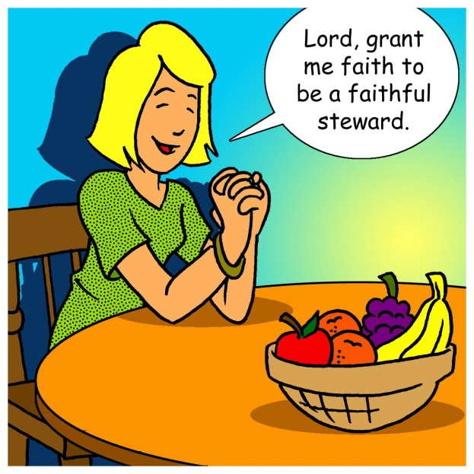
Part Two: The Joy of Managing God’s Blessings
Whether God gives us many years or few, much money or little, and many talents or few, we can manage all that He entrusts to us faithfully and joyfully.

Slide 17
The Joy of Managing God’s Blessings
In order for us to manage Gods blessings faithfully and responsibly, we need God’s wisdom.
Proverbs 9:10a points out, “The fear of the Lord is the beginning of wisdom.”
Bill Gothard said, “Wisdom is seeing things from God’s perspective.”
We receive wisdom as a gift from God (Proverbs 2:6).

Slide 18
The Joy of Managing God’s Blessings
Godly wisdom enables us to manage God’s blessings with an eternal perspective. Godly wisdom…
motivates us to seek after things that are right and pure.
motivates us to seek God’s direction as we follow His plan and manage His blessings.
is not popular with people with worldly interests.
will give us the ultimate victory over Satan and death.

Slide 19
The Joy of Managing God’s Blessings
Jesus gives two examples of people who managed God’s blessings with worldly wisdom rather than with God’s wisdom.
1. The Parable of the Rich Fool (Luke 12:13-21).
From a worldly perspective, he was a wise manager. His harvests were so large that he needed bigger barns. However, a lifetime of worldly wisdom made him a “fool.”
What was God’s response to this wealthy farmer? Why was God not pleased with how he managed his blessings?

Slide 20
The Joy of Managing God’s Blessings
2. The Rich Young Man (Mark 10:17-25).
Again from a worldly perspective, the Rich Young Man was a very successful money manager.
Knowing the Rich Young Man was in love with his money, Jesus asked him to sell everything and give it to the poor. Unable to do so, he left very sadly.
Why did Jesus ask him to sell everything?
How do we apply this to our lives?

Slide 21
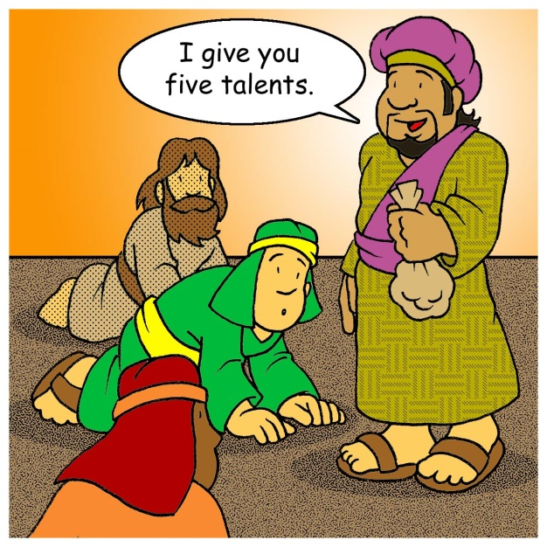
The Joy of Managing God’s Blessings
The Parable of the Talents (Matthew 25:14-30).
By telling us this parable, Jesus
lets us know that He is concerned
about the management of our
money.
God wants and expects us to use and
multiply the resources He entrusts to
us. Wise management of money pleases
the Lord.
How would you summarize the parable?
What did the master (Jesus) tell the two faithful servants? What did he say to the unfaithful one?

Slide 22
The Joy of Managing God’s Blessings
Summary of Part Two:
God enables and equips us to develop and manage the blessings He entrusts to us.
God wants us to rely on His wisdom to manage our blessings for His purposes.
God wants us to manage our blessings with an eternal perspective.
God fills us with joy as we manage our blessings faithfully.

Slide 23
Part Three: The Joy of Sharing God’s Blessings
Having received God’s blessings graciously and managed them faithfully, we can share them joyfully and generously.
“And God is able to make all grace abound to you, so that having all sufficiency in all things at al times, you may abound in every good work”
(2 Corinthians 9:8).

Slide 24
The Joy of Sharing God’s Blessings
“God loves a cheerful giver” (2 Corinthians 9:7).
In the words of author and pastor Randy Alcorn:
“The more we give, the more we delight in our giving—and the more God delights in us. Our giving pleases us. But more important it pleases God.
This doesn’t mean we should give only when we’re feeling cheerful. The cheerfulness often comes during and after the act of obedience, not before it. So don’t wait until you feel like giving—it could be a long wait! Just give and watch the joy follow…

Slide 25
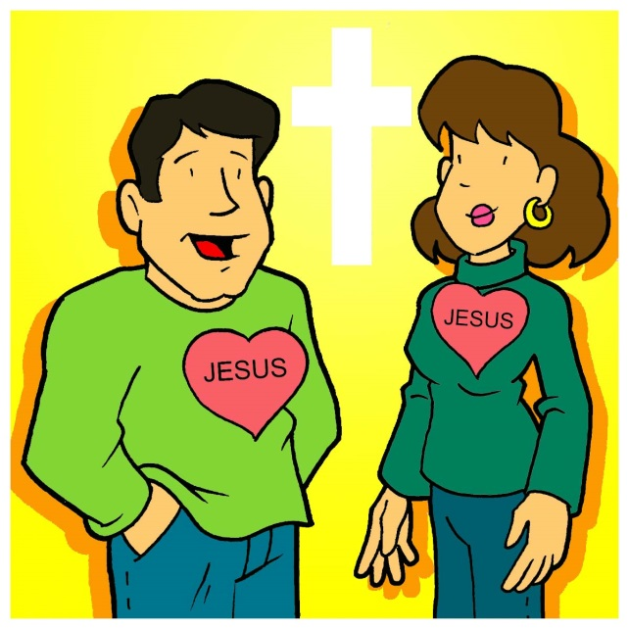
The Joy of Sharing God’s Blessings
Rev. Randy Alcorn’s quote continued:
God delights in our cheerfulness in giving. He wants us to find joy. He even commands us to rejoice (Philippians 4:4). What command could be a greater pleasure to obey than that one?
But if we don’t give, we’ve been
robbed of the source of joy God
instructs us to seek!”

Slide 26
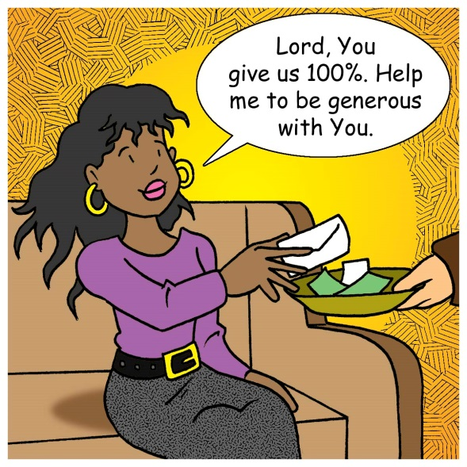
The Joy of Sharing God’s Blessings
The Grace of Giving
Giving is the work of God’s grace in our hearts.
“What God expects us to attempt He also enables us to achieve, and committed
Christians have proved it through-
out the centuries. So let us take
heart In knowing that the grace of
giving Is also the grace for giving.”
(Stephen F. Olford)

Slide 27
The Joy of Sharing God’s Blessings
Some key characteristics of the grace of giving found in 2 Corinthians 8:1-5:
We give despite our circumstances: The Macedonians were poor and had no hope of receiving anything from Paul, yet they gave joyfully and liberally.
We give enthusiastically: The Macedonians were more than willing to be included among those who gave offerings for the poor in Jerusalem; in fact, they begged to be included. Their giving was voluntary, motivated by the grace of God they had received.

Slide 28
The Joy of Sharing God’s Blessings
We give as Jesus gave: The Macedonians gave themselves first to God and then to others. Grace of giving is a mark of love for Christ.
We give willingly: The Macedonians were not forced. Their motivation was internal joy, gratitude, and a spirit of partnership in the body of Christ.
We give by faith: We obey God and believe He will meet our needs as we help to meet the needs of others.

Slide 29
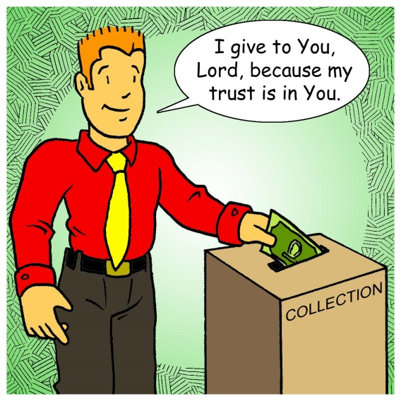
The Joy of Sharing God’s Blessings
We desire to honor God: The Macedonians desired to glorify God by using what he had given them in the way He wanted it used.
We give with a cooperative spirit: The
Macedonians desired to be partners
in the gospel and share with other
believers.
(Stewardship Study Bible)

Slide 30
The Joy of Sharing God’s Blessings
God’s people in Scripture gave very generously. The following is not intended to be a complete list of generous giving, but those chosen are good representatives of how God’s love and grace motivates His people:
Abraham’s gift of Isaac (Genesis 22:1-18)
Offerings for the Tabernacle (Exodus 36:4-7)
The Widow of Zarephath (1 Kings 17:9-16)
Gifts from King David (1 Chronicles29:2-3)

Slide 31
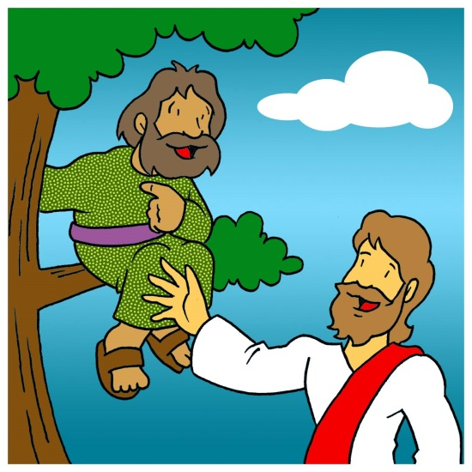
The Joy of Sharing God’s Blessings
The Good Samaritan (Luke 10:25-37)
The Widow’s Offering (Luke 21:1-4)
The Anointing of Jesus (Luke 7:36-38)
Generosity of the Macedonians (2 Corinthians 8:1-7)
Barnabas’ Gift (Acts 4:32-37)
The Giving of Zacchaeus
(Luke 19:1-10)

Slide 32
The Joy of Sharing God’s Blessings
Summary of Part Three:
God first gave so we can give.
God blesses us so we can bless others.
God’s grace enables our giving.
God gives us joy through our giving.

Slide 33
Stewardship Prayer:
Stewards You have made us, Lord, by creating us.
Stewards You have made us, Lord by redeeming us on Calvary’s cross.
Stewards You have made us, Lord, by calling us into Your family, the church.
Stewards you have made us, Lord, and entrusted us with every good gift.
Bless Your stewards, Lord, with Your forgiveness when we fail to manage Your good gifts wisely.
Bless Your stewards, Lord with gratitude for all Your gifts and the strength to use them for Your purposes.
In Jesus’ name we pray. Amen.

