Slide 2
Pastor:
We make our beginning in of the Father; and of the Son, and of the Holy Spirit.
People: Amen

Slide 3
Pastor:
I said, I will confess my transgressions to the Lord.
People:
And You forgave the iniquity of my sin.

Slide 4
Almighty God, our Maker and Redeemer, we poor sinners confess unto Thee, that we are by nature sinful and unclean, and that we have sinned against Thee by thought, word, and deed.
All:

Slide 5
Wherefore we flee for refuge to Thine infinite mercy, seeking and imploring Thy grace for the sake of our Lord Jesus Christ.
All:

Slide 6
Almighty God, our heavenly Father, hath had mercy upon us, and hath given us His only Son to die for us, and for His sake forgiveth us all our sins.
Them that believe on His name
The Absolution
Pastor:

Slide 7
He gives power to become sons of God, and hath promised them His Holy Spirit. He that believes and his Baptized shall be saved, Grant this, Lord, unto us all.
People: Amen.
The Absolution
Pastor:

Slide 8
Psalm 16
(selected verses)
Pastor:
Keep me safe, my God,
People:
for in you I take refuge.

Slide 9
Psalm 16
(selected verses)
Pastor:
I say to the Lord, “You are my Lord;
People:
apart from you I have no good thing.”

Slide 10
Psalm 16
(selected verses)
Pastor:
Therefore my heart is glad, and my tongue rejoices;
People:
my body also will rest secure,

Slide 11
Psalm 16
(selected verses)
Pastor:
because you will not abandon me to the realm of the dead,
People:
nor will you let your faithful one see decay.

Slide 12
All:
Glory be to the Father, and to the Son, and to the Holy Spirit; as it was in the beginning, is now, and will be forever. Amen.

Slide 13
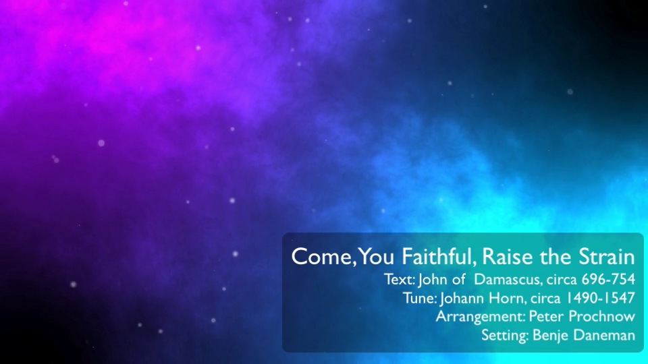

Slide 14
The Word of God
For the People of God

Slide 15
When the Sabbath was over, Mary Magdalene, Mary the mother of James, and Salome bought spices so that they might go to anoint Jesus' body.
The Holy Gospel

Slide 16
Very early on the first day of the week, just after sunrise, they were on their way to the tomb and they asked each other, “Who will roll the stone away from the entrance of the tomb?”

Slide 17
But when they looked up, they saw that the stone, which was very large, had been rolled away. 5As they entered the tomb, they saw a young man dressed in a white robe sitting on the right side, and they were alarmed.
The Holy Gospel

Slide 18
“Don't be alarmed,” he said. “You are looking for Jesus the Nazarene, who was crucified. He has risen! He is not here. See the place where they laid him. 7But go, tell his disciples and Peter, ‘He is going ahead of you into Galilee. There you will see him, just as he told you.’ ”
The Holy Gospel

Slide 19
Trembling and bewildered, the women went out and fled from the tomb. They said nothing to anyone, because they were afraid.
The Holy Gospel

Slide 20
When Jesus rose early on the first day of the week, he appeared first to Mary Magdalene, out of whom he had driven seven demons. She went and told those who had been with him and who were mourning and weeping.
The Holy Gospel

Slide 21
When they heard that Jesus was alive and that she had seen him, they did not believe it.
The Holy Gospel

Slide 22
The Sermon

Slide 23
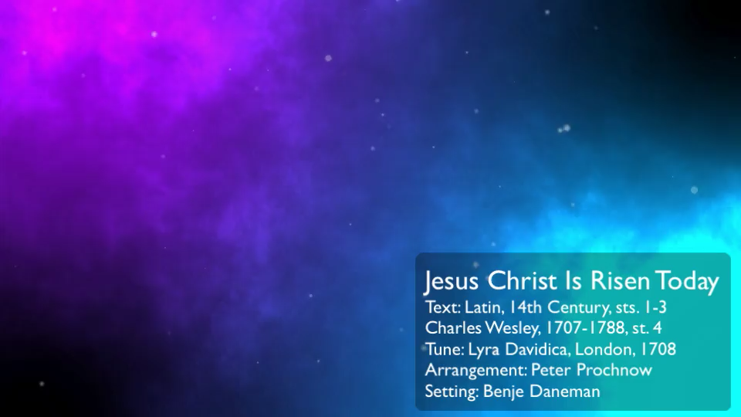

Slide 24
Each Petition will end with the words spoken by the pastor:
“Lord, In Your Mercy.”
You respond:
“Hear our prayers”
The Prayers

Slide 25
Our Father who art in heaven, hallowed be thy name. thy kingdom come, thy will be done on earth as it is in heaven.
Give us this day our daily bread;
The Lord’s Prayer

Slide 26
and forgive us our trespasses as we forgive those who trespass against us; and lead us not into temptation, but deliver us from evil.
For thine is the kingdom and the power and the glory forever and ever. Amen.
The Lord’s Prayer

Slide 27
